Slide 1
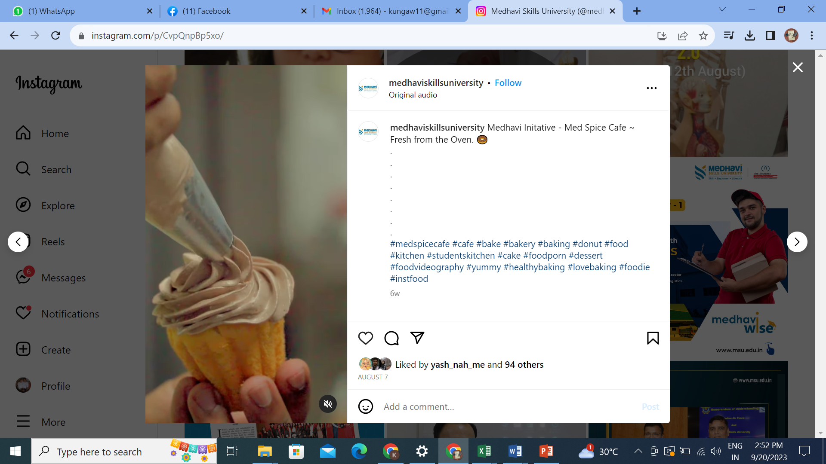



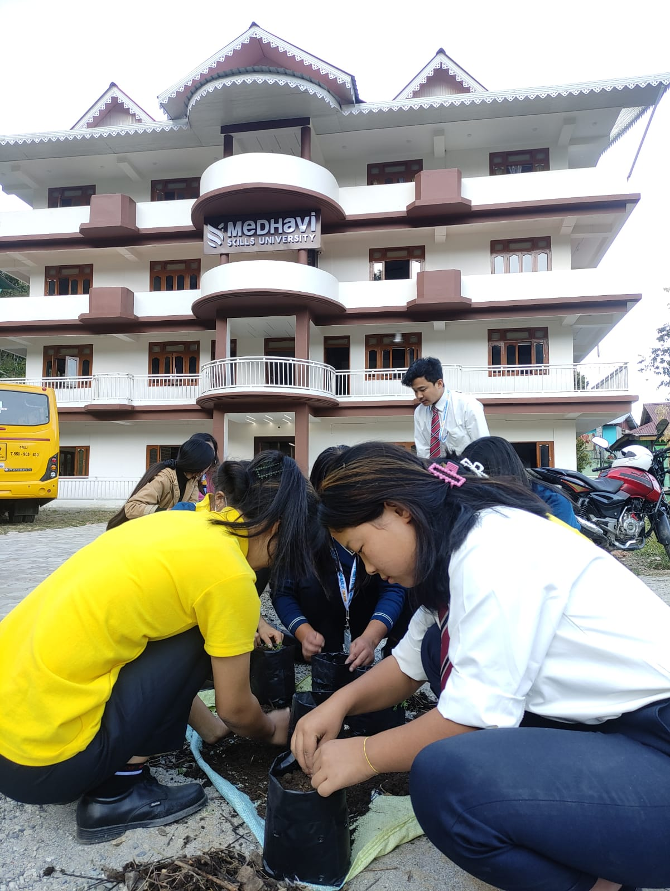



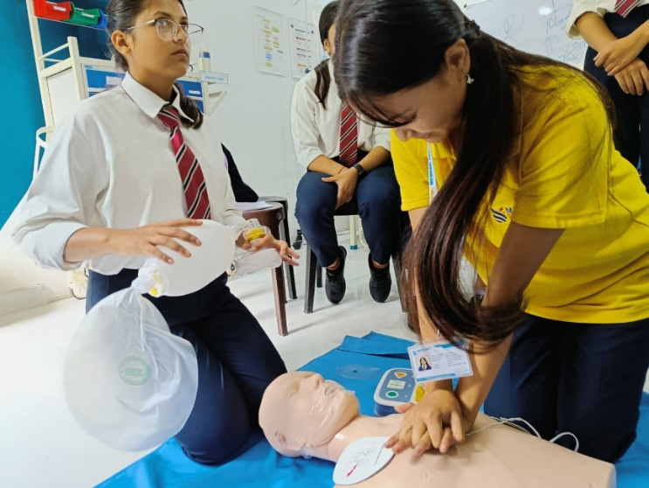
Skill Drill

Slide 2

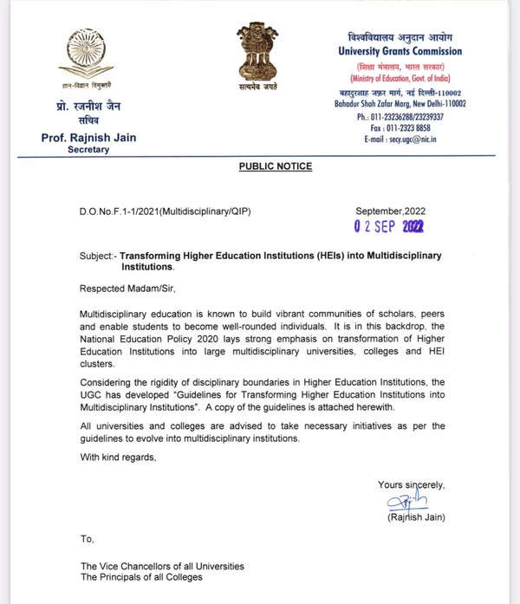
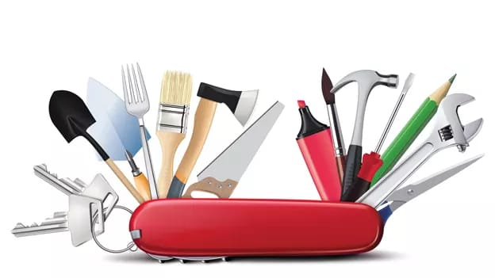
Purpose
Skill Drill
Strong link to NEP 2020 where vocational skills are focused
Skilling in a totally different discipline
Multidisciplinary problem-solving approach

Slide 3

MOBILE DEVELOPMENT WITH Adalo

Slide 4

COURSE INSIGHTS
Skill Drill
No-code development is rapidly growing, making Adalo a valuable tool for businesses, startups, and entrepreneurs.
Students gain hands-on experience in app design, database management, and API integration, helping them build real-world applications.
This course prepares students for roles in entrepreneurship, freelancing, and product development without requiring coding expertise.
No-code skills provide a strong foundation for transitioning into low-code or full-code development, keeping students adaptable in the tech industry.

Slide 5
WHY THE COURSE?
Skill Drill
Fast & Easy App Development – Build mobile apps without coding.
High-Demand Skill – No-code development is growing in the industry.
Career & Business Opportunities – Ideal for entrepreneurs and freelancers.
Hands-On Learning – Practical projects for real-world experience.

Slide 6

Course Learning Outcomes
Skill Drill
Create Mobile Apps – Design and build apps using Adalo without coding.
Manage Databases – Store and organize app data efficiently.
Design User Interfaces – Create visually appealing and user-friendly app layouts.
Build Functional Features – Add buttons, forms, and navigation for smooth app interaction.

Slide 7
THE LEARNING METHODS
Skill Drill
Hands on development
From paper to Implementation
Testing with real people
Real time development.

Slide 8
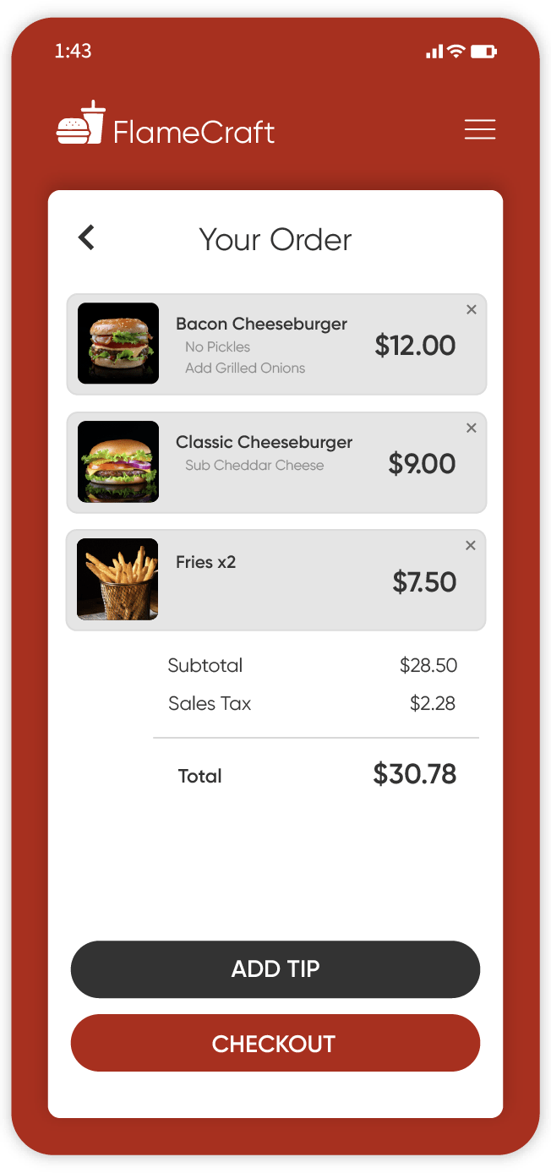
Course Achievement
Skill Drill
Be able to create a real world application and solve problems.

Slide 9
Skills Assessment Schema
Skill Drill
PRACTICAL SCHEMA
Internal (70 marks) |  |  | External (30 Marks)
On Job Performance/ Weekly Assessment (50 Marks) | Log Book/ Portfolio (15 Marks) | Attendance (5 marks) | Skill Test + Viva (30 Marks)

Slide 10


Registration
Skill Drill
Seat limit = 30
Registration Link:

Slide 11

Skill Drill

